Slide 1
PRESENTATION
ON
IP SECURITY
GROUP 4
GENEVIA NONGRUM
ALEXANDER NONGRUM

Slide 2
CONTENT
What is IP Security
IPSEC Service
IP Security Scenario
Benefits of IPSec
Network Layer Security
--IPSec protocols – AH protocol
--IPSec protocols – ESP protocol
How IPSec works

Slide 3
What is IP Security
Framework of open standards to ensure secure communications over the Internet
In short: It is the network layer Internet Security Protocol

Slide 4

IPSEC Service
Upper layer data
IP Header
Case 1 : Insecure IP Packet
Internet/
Intranet
IPSec disabled host
Upper layer data
IP Header
IPSec
Header
Case 2 : Secure IP Packet
IPSec enabled host

Slide 5
IPSec
general IP Security mechanisms
provides
authentication
confidentiality
key management
applicable to use over LANs, across
public & private WANs, & for the Internet.

Slide 6
IP sec Application
IPSec provides the capability to secure communications across a LAN, across
private and public WANs, and across the Internet.
Secure branch office connectivity over the Internet
Secure remote access over the Internet
Establishing extranet and intranet connectivity with partners
Enhancing electronic commerce security

Slide 7
Security Associations
One of the most important concepts in IPSec is called a Security Association (SA). Defined in RFC 1825.
SAs are the combination of a given Security Parameter Index (SPI) and Destination Address.
SAs are one way. A minimum of two SAs are required for a single IPSec connection.
SAs contain parameters including:
Authentication algorithm and algorithm mode
Encryption algorithm and algorithm mode
Key(s) used with the authentication/encryption algorithm(s)
Lifetime of the key
Lifetime of the SA
Source Address(es) of the SA
Sensitivity level (ie Secret or Unclassified)

Slide 8
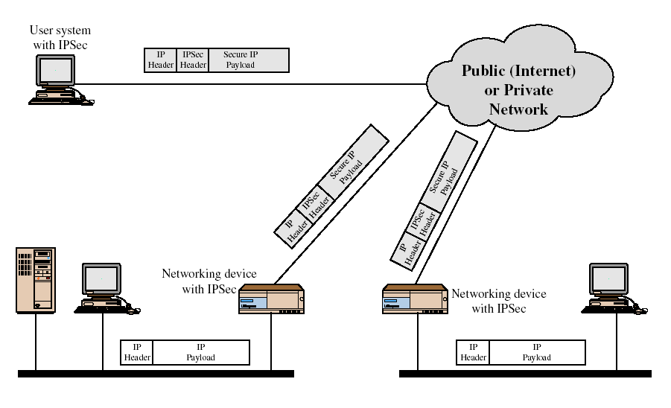
IP Security Scenario

Slide 9
Scenario Of Ipsec Usage
An organization maintains LANs at dispersed locations
Non secure IP traffic is conducted on each LAN.
IPSec protocols are used
These protocols operate in networking devices that connect each LAN to the outside world. (router, firewall )
The IPSec networking device will typically encrypt and compress all traffic going into the WAN, and decrypt and decompress traffic coming from the WAN

Slide 10
Benefits of IPSec
in a firewall/router provides strong security to all traffic crossing the perimeter
in a firewall/router is resistant to bypass
is below transport layer, hence transparent to applications
can be transparent to end users
can provide security for individual users
secures routing architecture

Slide 11
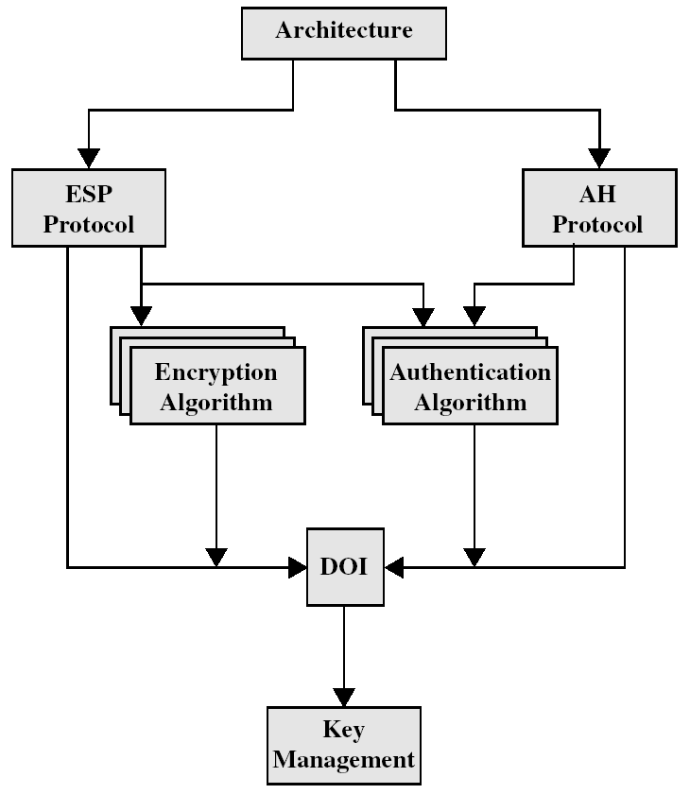
IPsec

Slide 12
Network Layer Security
IP security (IPsec)
Two protocols
Authentication protocol, using an Authentication Header (AH)
Encryption/authentication protocol, called the Encapsulating Security Payload (ESP)
Two modes of operation
Transport mode: provides protection for upper-layer protocols
Tunnel mode: protects the entire IP datagram

Slide 13
IPSec protocols – AH protocol
AH - Authentication Header
Defined in RFC 1826
Integrity: Yes, including IP header
Authentication: Yes
Non-repudiation: Depends on cryptography algorithm.
Encryption: No
Replay Protection: Yes
Transport Packet layout
IP Header
AH Header
Payload (TCP, UDP, etc)
Tunnel Packet layout
IP Header
AH Header
IP Header
Payload (TCP. UDP,etc)

Slide 14
IPSec protocols – ESP protocol
ESP – Encapsulating Security Payload
Defined in RFC 1827
Integrity: Yes
Authentication: Depends on cryptography algorithm.
Non-repudiation: No
Encryption: Yes
Replay Protection: Yes
Transport Packet layout
IP Header
ESP Header
Payload (TCP, UDP, etc)
Tunnel Packet layout
IP Header
ESP Header
IP Header
Payload (TCP. UDP,etc)
Unencrypted
Encrypted

Slide 15
IPSec Protocols (cont)
Algorithms Used:
Encryption:
Symmetric – As IP packets may arrive out of order and Asymmetric algorithms are incredible slow.
E.g. DES (Data Encryption Standard)
Authentication:
MAC (Message Authentication Codes) based on symmetric encryption algorithms.
One way hash functions. (MD5 or SHA-1)

Slide 16
Internet Key Exchange (IKE) is used to setup IPSec.
IKE Phase 1:
Establishes a secure, authenticated channel between the two computers
Authenticates and protects the identities of the peers
Negotiates what SA policy to use
Performs an authenticated shared secret keys exchange
Sets up a secure tunnel for phase 2
Two modes: Main mode or Aggressive mode

Slide 17
How IPSec works: Phase 1
Contd….
Main Mode IKE
Negotiate algorithms & hashes.
Generate shared secret keys using a Diffie-Hillman exchange.
Verification of Identities.
Aggressive Mode IKE
Squeezes all negotiation, key exchange, etc. into less packets.
Advantage: Less network traffic & faster than main mode.
Disadvantage: Information exchanged before a secure channel is created. Vulnerable to sniffing.

Slide 18
How IPSec works: Phase 2
An AH or ESP packet is then sent using the agreed upon “main” SA during the IKE phase 1.
IKE Phase 2
Negotiates IPSec SA parameters
Establishes IPSec security associations for specific connections (like FTP, telnet, etc)
Renegotiates IPSec SAs periodically
Optionally performs an additional Diffie-Hellman exchange

Slide 19
THANK
YOU

